Slide 1
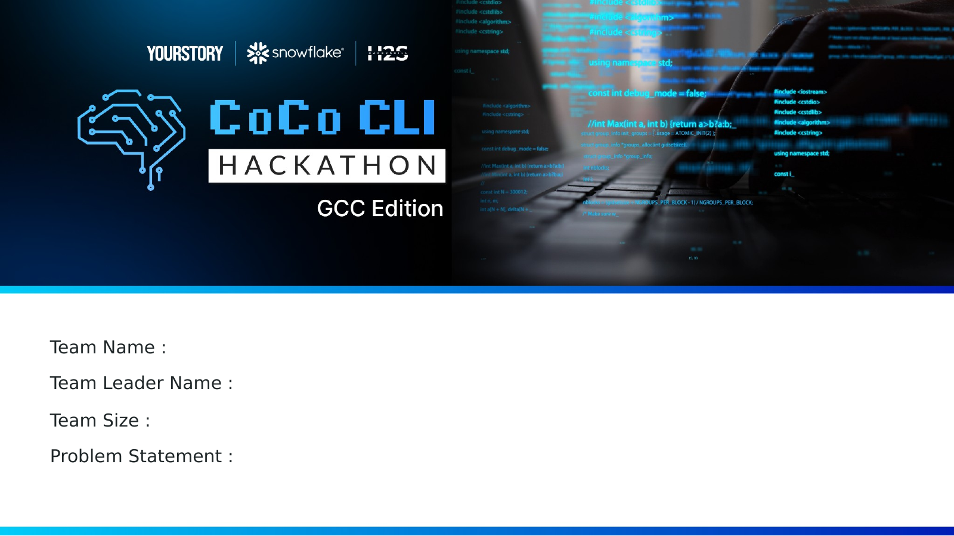
Insure360 AI
TEAM NAME :
Cocoteam
Unified Customer 360 & Next Best Action Copilot
TEAM LEADER NAME :
Manideep Marka
Structured + unstructured insurance intelligence powered by Snowflake Cortex AI and Streamlit
1
TEAM SIZE :
PROBLEM STATEMENT :
Customer 360 & Next Best Action Copilot
Cocoteam | Manideep Marka

Slide 2

Executive Summary
A judge-ready view of the problem, solution, innovation and outcome.
PROBLEM
SOLUTION
INNOVATION
OUTCOME
Fragmented context
One workspace
Structured + unstructured AI
Insight to action
Agents switch across policy, claims, payment and interaction records before deciding how to respond.
Insure360 AI consolidates customer context and AI-assisted insights in Streamlit.
Cortex AI converts transcripts and operational data into sentiment, summaries, Q&A and recommendations.
Agents move from portfolio signals to Customer 360, Next Best Action and approval.
ONE-LINE PITCH
Understand the customer faster. Explain what matters. Take the next best action.
Customer 360 • Cortex AI • Sentiment • Next Best Action • Approval

Slide 3
1. Problem Brief
Why insurance service teams need a unified, decision-ready customer view.
1
SEARCH
Customer details are distributed across operational views.
THE OPPORTUNITY
Make customer context immediately usable
2
ASSEMBLE
Agents manually connect policy, claim, payment and interaction context.
Connect what happened, why it matters and what the agent should do next.
3
INTERPRET
Call transcripts are difficult to consume during a live decision.
✓ Unified customer history
4
DECIDE
Action selection depends on individual interpretation.
✓ Explainable AI-assisted insight
✓ Repeatable next-action workflow

Slide 4
2. Solution Overview
Monitor → Understand → Assist → Act.
1
2
3
4
MONITOR
UNDERSTAND
ASSIST
ACT
Portfolio risk, overdue payments, claims and renewals.
Customer 360 with policies, claims, payments and timeline.
Sentiment, summary, executive brief and Q&A.
Next Best Action, approval and follow-up.
One workspace. One customer story. One informed next step.

Slide 5
3. Architecture
A modular Snowflake flow from data sources to agent action.
1
2
3
4
5
DATA SOURCES
UNIFIED LAYER
CORTEX AI
BUSINESS LOGIC
STREAMLIT APP
Customers
Policies
Claims
Payments
Transcripts
Customer 360 views
Entity joins
Timeline
Risk signals
Sentiment
Summary
Executive brief
Q&A
Next Best Action
Priority logic
Approval state
Portfolio
Customer 360
AI workspace
Action flow
CoCo CLI accelerated SQL/code iteration, troubleshooting and documentation across the prototype lifecycle.

Slide 6
4. Data Foundation
Five data domains create a reusable Customer 360 and interaction timeline.
1
2
3
4
5
CUSTOMER
POLICY
CLAIMS
PAYMENTS
TRANSCRIPTS
Profile and relationship context
Coverage, premium and renewals
Status, amount and resolution
Transactions and overdue signals
Customer calls and concerns
UNIFIED CUSTOMER 360 LAYER
Decision-ready SQL views connect customer facts, financial signals and interaction history.

Slide 7
5. AI Intelligence Layer
How Cortex AI transforms customer context into explainable guidance.
INPUT
SENTIMENT
Tone and urgency
AGENT OUTPUT
Context package
Explainable guidance
SUMMARY
Concise context
Customer call transcript
Policy, claim and payment context
✓ What changed
✓ Why it matters
✓ What to do next
✓ Approval-ready action
EXECUTIVE BRIEF
Cross-domain snapshot
Q&A
Natural-language answers
NBA
Recommended follow-up
AI supports the decision. The approval step keeps the final action explicit and governed.

Slide 8
6. Why Insure360 AI Stands Out
Not a standalone chatbot. A complete journey from data to decision to action.
TRADITIONAL EXPERIENCE
INSURE360 AI
Fragmented and manual
Connected and actionable
× Multiple screens and records
× Manual transcript interpretation
× No connected recommendation workflow
× Inconsistent agent decisions
✓ One Customer 360 workspace
✓ Structured + unstructured context
✓ AI summary, Q&A and Next Best Action
✓ Approval-oriented follow-up
Differentiator: insight generation is connected to a visible, governed action workflow.

Slide 9
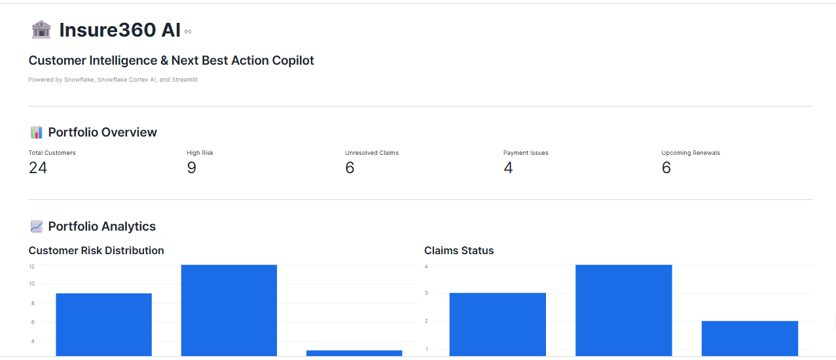
7. Prototype: Monitor the Portfolio
Surface customer risk and operational signals before the next interaction.
JUDGE VIEW
What to notice
Portfolio metrics
Risk distribution
Claims, payment and renewal signals
Portfolio analytics

Slide 10
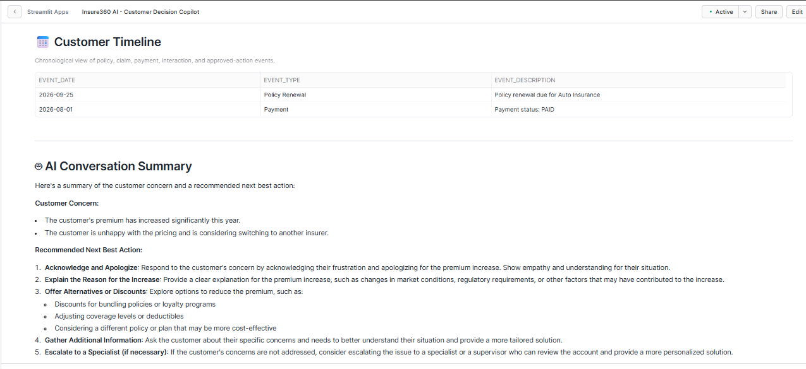
8. Prototype: Understand the Customer
Bring profile, timeline and AI-generated context into one decision view.
CUSTOMER 360
Decision context
Customer details
Interaction timeline
AI summary
Grounded recommendation
Customer 360, timeline and AI summary

Slide 11
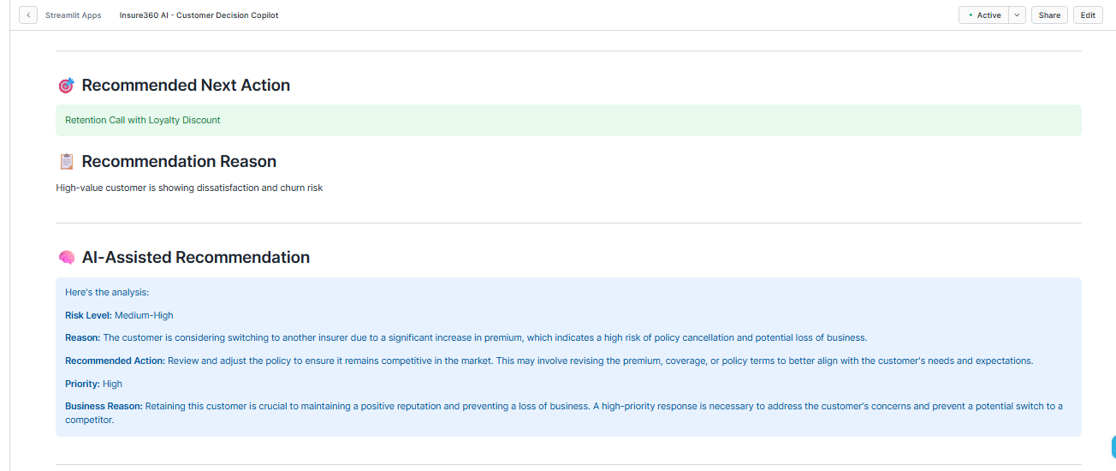
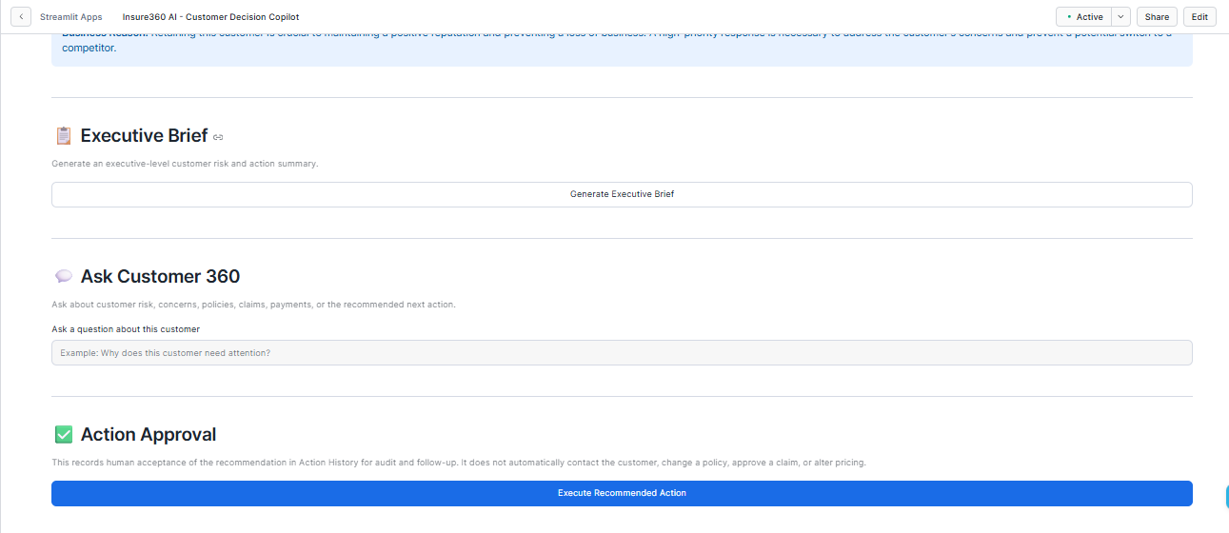
9. Prototype: Assist and Act
Convert customer context into a recommendation and approval-ready action.
Next Best Action
Executive Brief, Q&A and Approval

Slide 12
10. Impact and Scale
Expected value today, with a path from prototype to operational adoption.
OUTCOME
CONSISTENCY
VISIBILITY
Faster understanding
Guided decisions
Earlier awareness
A unified view reduces manual context gathering before customer engagement.
AI summaries and recommendations create a repeatable service experience.
Portfolio and customer views surface risk before the next interaction.
REUSE
Extend across products
INTEGRATE
Connect to CRM workflows
LEARN
Refine using outcomes

Slide 13

Cocoteam | Manideep Marka
Insure360 AI

